Slide 1
Budget Open Forums
February 2018

Slide 2
Institutional Revenues
State Appropriations
Tuition (minus Financial Aid)
Room and Board
Grants
Gifts/Endowment Distributions
Misc. (e.g. Royalties, leases)

Slide 3
% of Operating Revenues – Year 2000
In the year 2000, what % of our operating budget revenues was State Appropriations?
20%
25%
30%
35%
40%

Slide 4
% of Operating Revenues – Year 2000
In the year 2000, what % of our operating budget revenues was State Appropriations?
20%
25%
30%
35%
40%
Answer: d) 35%

Slide 5
% of Operating Revenues - Today
Today, what % of our operating budget revenues are from State Appropriations?
20%
25%
30%
35%
40%

Slide 6
% of Operating Revenues - Today
Today, what % of our operating budget revenues are from State Appropriations?
20%
25%
30%
35%
40%
Answer: a) 20%

Slide 7
State Appropriations Factors influencing Budget Planning
State Support of Instruction (SSI)
Legislature determines statewide subsidy pool
Individual university share determined via formula-based allocation (SSI Model)
SSI Model has been volatile
Funding to subsidize the cost of education
Performance-based – Course & Degree Completions
Medical, Doctoral components

Slide 8
Tuition (minus Financial Aid) Factors influencing Budget Planning
Recruitment
Retention & Completion Rates
Tuition Rates
Tuition caps
% of students returning
Time to degree
Peer/Competitive benchmarks
OHIO Guarantee: cohort increases; Tuition cap + CPI
New freshmen & transfers
Resident/Non-resident/International
Grad/UG; Athens, Regionals, Dublin, eLearning
Financial Aid Strategy

Slide 9
Undergraduate Enrollment
Our Fall 2017 Athens new freshmen enrollments are lower than the previous two Fall semesters enrollments. How much have they declined (Fall 2017 vs. Fall 2015)?
120 (student headcount)
221
378
410
505

Slide 10
Undergraduate Enrollment
Our Fall 2017 Athens new freshmen enrollments are lower than the previous two Fall semesters enrollments. How much have they declined (Fall 2017 vs. Fall 2015)?
120 (student headcount)
221
378
410
505
Answer: c) 378

Slide 11
Annual Tuition Increases
National Average data: College Board, Annual Survey of Colleges

Slide 12
Regional Campus Enrollments
How many years in a row has Fall credit hour production declined at the Regional Campuses?
4
5
6
7
8

Slide 13
Regional Campus Enrollments
How many years in a row has Fall credit hour production declined at the Regional Campuses?
4
5
6
7
8
Answer: e) 8

Slide 14
Enrollment – FY00 vs FY17
Growth in UG-eLearning
Growth in Grad/Medical
Growth in UG-Athens
~40% Growth overall

Slide 15
Institutional Revenues – FY00 vs FY18
Little growth in SSI despite enrollment increase
Growth in Tuition
Growth in Room/Board
Growth in Gifts/Endowment

Slide 16
Institutional Revenues
Challenges/Constraints
Regional Enrollments
Level of State Subsidy
Tuition Caps
Financial Aid /
Discount Rate
Declining high school graduates in Ohio
Out-of-state, International student enrollments

Slide 17
Salaries and Wages Factors influencing Budget Planning
Raise Pool
Market rates of increase
Faculty Investment Plan
Improving competitive position
Staff Investment Plan
COMP 2014 and biennial equity review
Employee recognition

Slide 18
Benefits Factors influencing Budget Planning
Healthcare
Cost inflation
Other Benefits
Education Benefit usage
Plan design
University vs. Employee share
Workers Compensation costs
Eligibility

Slide 19
Capital Plan/ Internal Loans Factors influencing Budget Planning
Use of Debt
Debt Capacity/Rating
Ability to repay
Level of Capital Investment
Deferred Maintenance needs
Utility Infrastructure
Programmatic needs (e.g. classroom technology; library configuration)

Slide 20
Capital Plan – FY12 Operating Impact
In FY12, what % of our Board-approved operating budget was dedicated to supporting our capital plan?
3%
4%
5%
6%
7%

Slide 21
Capital Plan – FY12 Operating Impact
In FY12, what % of our Board-approved operating budget was dedicated to supporting our capital plan?
3%
4%
5%
6%
7%
Answer: a) 3%

Slide 22
Capital Plan – FY18 Operating Impact
Today, what % of our Board-approved operating budget is dedicated to supporting our capital plan?
5%
6%
7%
8%
9%

Slide 23
Capital Plan – FY18 Operating Impact
Today, what % of our Board-approved operating budget is dedicated to supporting our capital plan?
5%
6%
7%
8%
9%
Answer: c) 7%
Example Capital Projects
Academic Renovations
Clippinger
McCracken
Schoonover
Ellis
Tupper
Building Systems/Infrastructure
Roofs
Utility Systems
Building Envelope
Housing Development Plan – Phase 1
HCOM Campus Development

Slide 24
Capital Plan – Deferred Maintenance
How much would it cost to address today’s deferred maintenance need (as measured in our Capital Improvement Plan & Utility Master Plan)
$250M
$350M
$450M
$550M
$650M

Slide 25
Capital Plan – Deferred Maintenance
How much would it cost to address today’s deferred maintenance need (as measured in our Capital Improvement Plan & Utility Master Plan)
$250M
$350M
$450M
$550M
$650M
Answer: d) $550M

Slide 26
Capital Plan – FY18 Investments
How much deferred maintenance is budgeted to be addressed in FY18?
$50M
$70M
$90M
$120M
$150M

Slide 27
Capital Plan – FY18 Investments
How much deferred maintenance is budgeted to be addressed in FY18?
$50M
$70M
$90M
$120M
$150M
Answer: b) $70M

Slide 28
Capital Plan – Student Housing
By 2022, what % of our student housing will be older than 50 years? (measured by Renovation Age, which represents the number of years since major renovations/investment)
21%
27%
32%
44%
59%

Slide 29
Capital Plan – Student Housing
By 2022, what % of our student housing will be older than 50 years? (measured by Renovation Age, which represents the number of years since major renovations/investment)
21%
27%
32%
44%
59%
Answer: e) 59%

Slide 30
Institutional Investments/Expenses
Challenges/Constraints
Competitive Compensation
Healthcare cost inflation
Deferred Maintenance
Strategic Academic/Research Growth
Student/Public Expectations
Protecting Academic Excellence

Slide 31
Decision-making Structure
What is the role of shared governance in OHIO’s budget process?

Slide 32
Resource Allocation Decisions: Central, Planning Unit, & Dept.
Central Decisions
Raise Pool
Benefits
Debt Strategy
Institutional Investments
UG Enrollment
State Support
Tuition Rates
Planning Unit* Decisions
Graduate / Online Enrollment
Allocation of Raise Pools
Staffing/Replacements/Hiring
Support Pathways/Priorities
Capital Project Prioritization
Program Priorities/Reallocations
Dept/Division Responsibility
Recruiting/Yield Efforts
Faculty/Staff Workload
Curriculum delivery
Academic outcomes
Student Success/Service
Efficiency/Service level
Compliance/Accreditation
* Planning Units are defined as colleges (led by Deans) or administrative/support units (led by Executive staff)

Slide 33
Ongoing Tension Between Investment Needs and Available Resources
Constrained Resources
Declining State Support
Tuition Constraints
Shifting Enrollment Demographics
Increased Financial Aid
Healthcare Cost Escalation
Deferred Maintenance
Competitive Compensation
Investment Needs
Addressing our financial challenges requires all areas of University to be a part of the solution

Slide 34
Budget Development – Fall Financial Review
Initial Central Assumptions
Revenues
State Share of Instruction (0%)
Undergraduate Tuition Rates (1.3% new Freshmen only; 0% for all others)
UG Enrollment (-150 = $2.1M)
OTO Support from SOR (= -3.8M)
Auxiliary Contribution to SFA (=500K)
Expenses
Potential Raise Pool (= $9.3M))
Health Care Costs (5% = $2.5M))
Financial Aid (=+1.5M)
Online Learning Investment (=+$1M)
Utilities (=+600K)
POM (=+200K)
Admin Cost Reductions (=-$2.3M)
College Initial Forecasts
Revenues – Usually Conservative
Off-Campus Graduate Programs
Online Programs
On-Campus Graduate Programs and Waivers
External Sales
Grant Revenue
Gift and Endowment Revenue
Expenditures –Usually Maximized
Hiring forecasts
Expenses for new programs
Grant Expenditures
Supplies and Services
Typically Results in $15-20M Imbalance; $23M This Year

Slide 35
Budget Development – January Refinement
Revised Central Assumptions
Revenue
Adjusted SSI Forecast (=+$3.2M with 1.9M shift from RHE to Athens)
Scholarship Leveraging Investment (=+2.1M Investment to Yield 99 more students; Net Tuition Impact = +500K)
Decreased Retention Projection (=-400K)
Expenses
Changes to Compensation Assumptions (= -$1.3M; Raise Pool from 2% to 1.5%)
Health Care Costs (= -$1.25M; 5% reduced to 2.5% )
College Updated Forecasts
More Accurate Revenue Projections for graduate and online enrollments
Additional off-campus programs in Business (Analytics, MS in Management, Master’s of Accountancy), Education (Master’s in Tennis Coaching), Fine Arts (BFA Film, MFA Music Education, MFA Art Therapy), Health Sciences (Online Social Work)
More Accurate Expenditure Projections
Renegotiated Pearson contracts
Reductions to vacant lines
Updated results from searches
Just wrapping up February round of financial reviews with each college
Resulted in 5.9M reduction to imbalance
Projected $1.3M reduction to imbalance
$23M Imbalance Currently Reduced to $15.8M

Slide 36
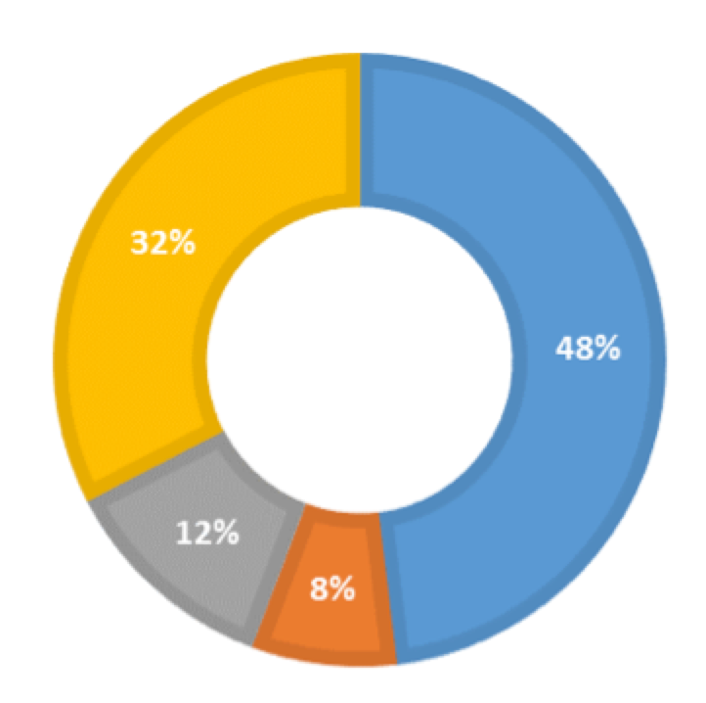
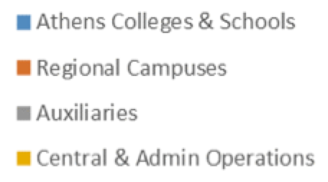
Budget Development – Next Steps
Continued Refinement of College Revenue/Expense Projections
Updating information gathered from theoretical 7% reduction exercise
College Targets – Not Set Yet
Can be a combination of additional revenue and expense reduction
Reduction Proportionality - Not greater than nor over a shorter period of time compared to Administrative reductions
Strategic Reductions – Bridging strategies are being developed to ensure that any college reductions are as strategic as possible
Ç√

Slide 37
Budget Development – Next Steps
Planning Unit | 7% Target | FY18 Reductions: | FY19 Reductions: | FY20 Reductions
Graduate College | $108,325 | $77,543 | $- | $30,782
VP of Research | $234,442 | $167,458 | $66,984 | $-
Provost (Excluding Diversity & Inclusion) | $310,887 | $264,306 | $46,581 | $-
Diversity & Inclusion | Exempt | Exempt | Exempt | Exempt
Enrollment Management | $725,060 | $260,122 | $141,000 | $323,938
Subtotal - Provost Academic Support | $1,378,714 | $769,429 | $254,565 | $354,720
ISFS | $35,203 | $25,145 | $10,058 | $-
Library | $806,224 | $391,354 | $83,870 | $331,000
Instructional Innovation | $180,000 | $180,000 | $- | $-
Subtotal - Provost Academic | $1,021,427 | $596,499 | $93,928 | $331,000
OIT | Exempt | Exempt | Exempt | Exempt
Airport | $40,057 | $- | $- | $40,057
VP Finance & Administration | $3,739,802 | $2,000,000 | $889,930 | $849,872
Subtotal - VPFA | $3,779,859 | $2,000,000 | $889,930 | $889,929
President | $445,821 | $220,207 | $70,312 | $155,302
Campus Recreation | $224,913 | $160,652 | $29,534 | $34,727
VP of Student Affairs | $575,270 | $410,931 | $82,143 | $82,196
Subtotal - VPSA | $800,183 | $571,583 | $111,677 | $116,923
VP of Advancement | $183,221 | $- | $91,611 | $91,610
WOUB | $159,771 | $114,122 | $22,824 | $22,825
Athletics | $677,249 | $483,750 | $- | $193,499
Child Development Center | $18,000 | $18,000 | $- | $-
Kennedy Museum | $19,142 | $19,142 | $- | $-
Total Admin Units | $8,483,387 | $4,792,732 | $1,534,847 | $2,155,808
Administrative Units
Still committed to 7% reductions to base funding from FY18 to FY20
Have achieved reductions in FY18 of 3% to 5%, depending on unit
Plans being submitted to achieve the remainder of the 7%
Minimize impact on academic mission
Additional reductions are possible
Provost Units: ECRC, Registrar, Admissions, IR, Instructional Innovation, Library, VPR, Grad College, Omsbud
Finance & Admin Units: Finance, Facilities, Design & Construction, Budget, OUPD, Human Resources, Business Systems
Student Affairs: Campus Rec, CLDC, Counseling & Psych Services, Event Services, Campus Involvement Center

Slide 38
Regional Campuses
Enrollments inverse of overall economy (enrollments decline when economy is good)
Enrollment decline: loss of tuition
SSI model changes – Shift from RHE to Athens (-1.9M)
Significant efforts to reduce costs over several years
Centralized scheduling
Reduction of adjuncts and part-time teaching
Shared Administrative Services
ERIP being used to reduce staffing costs

Slide 39
Auxiliary Contributions
Growth in Contributions to Financial Aid
offsets impact to Colleges
Reevaluation of capital investments (timing/scope)
While recent enrollment increases have provided additional revenue beyond that modeled for the Housing Capital Plan, those gains have eroded while contribution to scholarships has been added

Slide 40
Staff Headcount Analysis
Working with Faculty Senate Facilities & Finance Subcommittee to analyze staff headcount growth using a common Data Set
Primary growth areas
Facilities (space growth; capital construction)
Academic programs (e.g. Advising, HCOM campuses; grad programs)
Online Education
Enrollment Management
Instructional Innovation – Marketing, Advising and Course Development
Career/Leadership development
Complexities in comparing across years
Department reorganizations
FLSA reclassifications
Centralizing services
Changes in institutional requirements, size

Slide 41
Questions?

